Slide 3
OUTLINE
Importance
Capital Budgeting Process
Project Classification
Investment Criteria
Net Present Value
Benefit Cost Ratio
Internal Rate of Return
Modified Internal Rate of Return
Payback Period
Accounting Rate of Return

Slide 4
CAPITAL EXPENDITURES AND THEIR IMPORTANCE
The basic characteristics of a capital expenditure (also referred to as a capital investment or just project) is that it involves a current outlay (or current and future outlays) of funds in the receiving a stream of benefits in future.
Importance stems from:
Long-term consequences
Substantial outlays
Difficulty in reversing

Slide 5
CAPITAL BUDGETING PROCESS
Identification of Potential Investment Opportunities
Assembling of Investment Proposals
Decision Making
Preparation of Capital Budget and Appropriations
Implementation
Performance Review

Slide 6
PROJECT CLASSIFICATION
Mandatory Investments
Replacement Projects
Expansion Projects
Diversification Projects
Research and Development Projects
Miscellaneous Projects

Slide 7
INVESTMENT CRITERIA

Slide 8
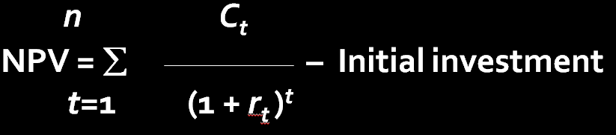
NET PRESENT VALUE

Slide 9
NET PRESENT VALUE
The net present value of a project is the sum of the present value of all the cash flows associated with it. The cash flows are discounted at an appropriate discount rate (cost of capital).
NAVEEN ENTERPRISE’S CAPITAL PROJECT
Year | Cash Flow | Discount Factor | Present Value
0 | -100.00 | 1.000 | -100.00
1 | 34.00 | 0.870 | 29.58
2 | 32.50 | 0.756 | 24.57
3 | 31.37 | 0.658 | 20.64
4 | 30.53 | 0.572 | 17.46
5 | 79.90 | 0.497 | 39.71
 |  |  | Sum = 31.96
PROS
Reflects the time value of money
Considers the cash flow in its entirely
Squares with the objective of wealth maximisation
CONS
Is an absolute measure and not a relative measure

Slide 10
BENEFIT COST RATIO
PVB
Benefit-cost Ratio : BCR =
I
PVB = present value of benefits
I = initial investment
To illustrate the calculation of these measures, let us consider a project which is being evaluated by a firm that has a cost of capital of 12 percent.
Initial investment : Rs 100,000
Benefits: Year 1 25,000
Year 2 40,000
Year 3 40,000
Year 4 50,000
The benefit cost ratio measures for this project are:
25,000 40,000 40,000 50,000
(1.12) (1.12)² (1.12)³ (1.12)⁴
BCR = = 1.145
100,000
PROS CONS
Measures bang per buck Provides no means for aggregation
+
+
+

Slide 11
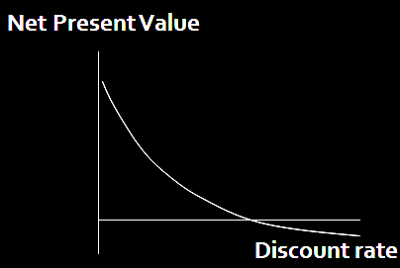
INTERNAL RATE OF RETURN
The internal rate of return (IRR) of a project is the discount rate that makes its NPV equal to zero. It is represented by the point of intersection in the above diagram
NET PRESENT VALUE
Assumes that the discount rate (cost of capital) is known.
Calculates the net present value, given the discount rate.
INTERNAL RATE OF RETURN
Assumes that the net present value is zero.
Figures out the discount rate that makes net present value zero.

Slide 12
CALCULATION OF IRR
You have to try a few discount rates till you find the one that makes the NPV zero
Year Cash Discounting Discounting Discounting
flow rate : 20% rate : 24% rate : 28%
Discount Present Discount Present Discount Present
factor Value factor Value factor Value
0 -100 1.000 -100.00 1.000 -100.00 1.000 -100.00
1 34.00 0.833 28.32 0.806 27.40 0.781 26.55
2 32.50 0.694 22.56 0.650 21.13 0.610 19.83
3 31.37 0.579 18.16 0.524 16.44 0.477 14.96
4 30.53 0.482 14.72 0.423 12.91 0.373 11.39
5 79.90 0.402 32.12 0.341 27.25 0.291 23.25
NPV = 15.88 NPV = 5.13 NPV = - 4.02

Slide 13
CALCULATION OF IRR
NPV at the smaller rate
Sum of the absolute values of the
NPV at the smaller and the bigger
discount rates
5.13
24% + 28% - 24% = 26.24%
5.13 + 4.02
Smaller
discount +
rate
Bigger Smaller
X discount – discount
rate rate

Slide 14
PAYBACK PERIOD
Payback period is the length of time required to recover the initial
outlay on the project
NAVEEN ENTERPRISE’S CAPITAL PROJECT
Year Cash flow Cumulative cash flow
0 -100 -100
1 34 - 66
2 32.5 -33.5
3 31.37 - 2.13
4 30.53 28.40
PROS CONS
• Simple • Fails to consider the time value
of money
• Rough and ready method • Ignores cash flows beyond the
for dealing with risk payback period
• Emphasises earlier cash inflows

Slide 15
AVERAGE RATE OF RETURN
Average PAT
Average Book Value of Investment (Beginning)
NAVEEN ENTERPRISE’S CAPITAL PROJECT
Year Book Value of PAT
Investment(Beg)
1 100 14
2 80 17.5
3 65 20.12
4 53.75 22.09
5 45.31 23.57
1/5 (14+17.5 +20.12+22.09+23.57)
1/5(100+80+65+53.75+45.31)
PROS CONS
• Simple • Based on accounting profit,
• Based on accounting information not cash flow
businessmen are familiar with • Does not take into account the
• Considers benefits over the entire project life time value of money
ARR =
= 28.31%

Slide 16
INVESTMENT APPRAISAL IN PRACTICE
Over time, discounted cash flow methods have gained in importance and internal rate of return is the most popular evaluation method.
Firms typically use multiple evaluation methods.
Accounting rate of return and payback period are widely employed as supplementary evaluation methods.

Slide 17
SUMMING UP
n C_{t}
NPV = ∑ – I
t = 1 (1 + r)^{t}
PVB
BCR =
I
IRR is the value of r in the following equation
n C_{t}
I = ∑
t = 1 (1 + r)^{t}
MIRR is calculated as follows:
TV
PVC =
(1 + MIRR)^{n}
The payback period is the length of time required to recover the initial cash outlay on the project
The accounting rate is defined as:
Average profit after tax
Average book value of investment

